Slide 1

Electronic Health Record Predictor
Shailesh Kumar Jha
Dheeraj Reddy Jeeru

Slide 2
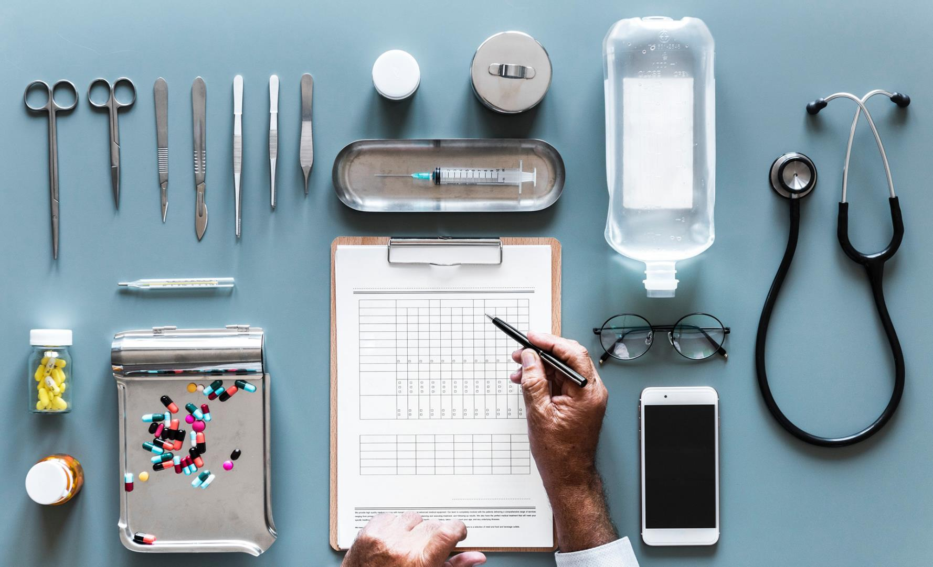
In a nutshell…
Introduction
The Idea
Dataset
Deep Dive
Bottlenecks
Results
The Road Ahead

Slide 3

Introduction
What is EHR?
Why is it important?
Issues
page 3

Slide 4

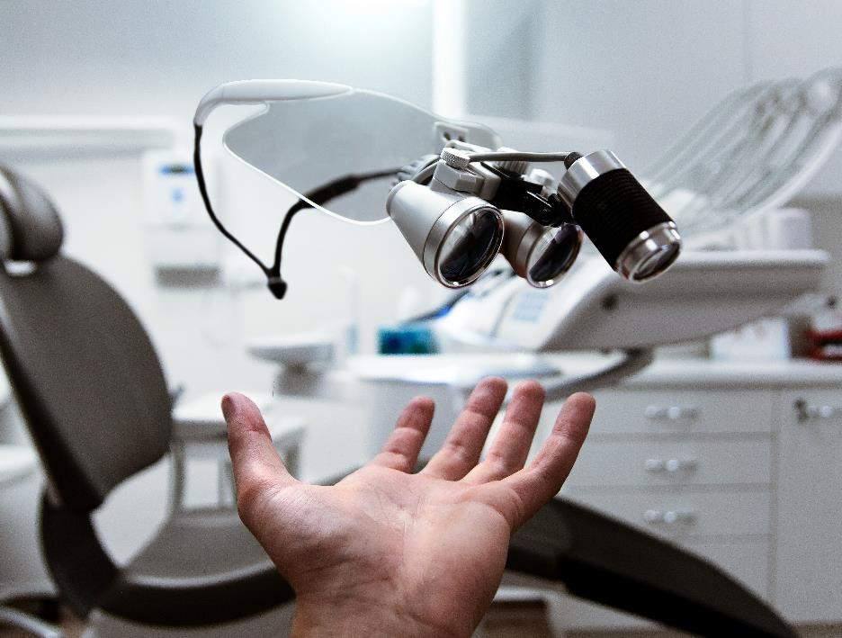
The Idea
Help doctors work efficiently
Help patients get faster consultation
Leverage technology for automation

Slide 5
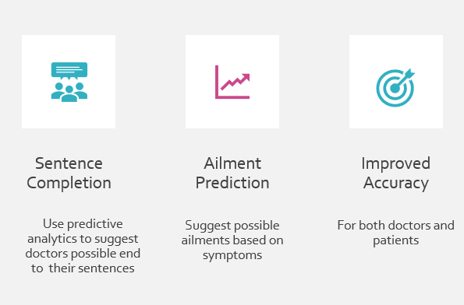
In Detail…

Slide 6
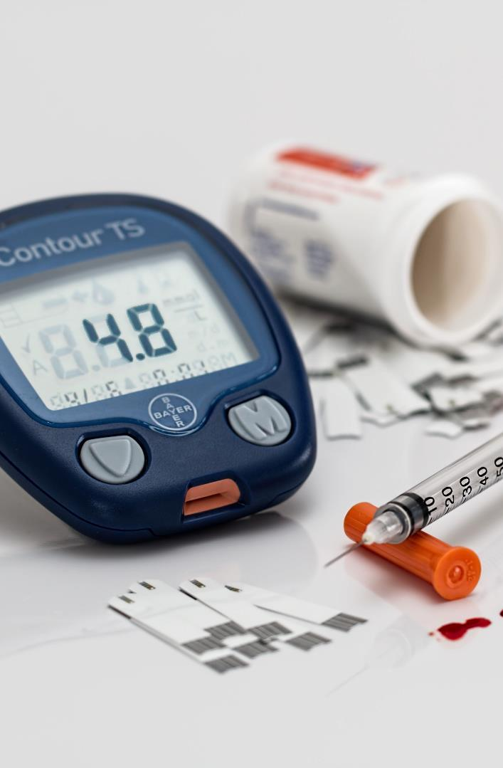
The Dataset
UCI Machine Learning Repository
215063 Instances
Recent data from year 2018
URL: https://archive.ics.uci.edu/ml/datasets/Drug+Review+Dataset+%28Drugs.com%29
Sentence Completion
Improved Accuracy
Use predictive analytics to suggest doctors possible end to their sentences
For both doctors and patients

Slide 7
Deep Dive
Language Model
LSTM
Seq2Seq modelling

Slide 8
Language Model
The goal of a LM is to break up a text corpus and assign probabilities to text sequences, typically one word at a time
A word based LM estimates the probability of P, one word at a time using the chain rule of probability.

Slide 9
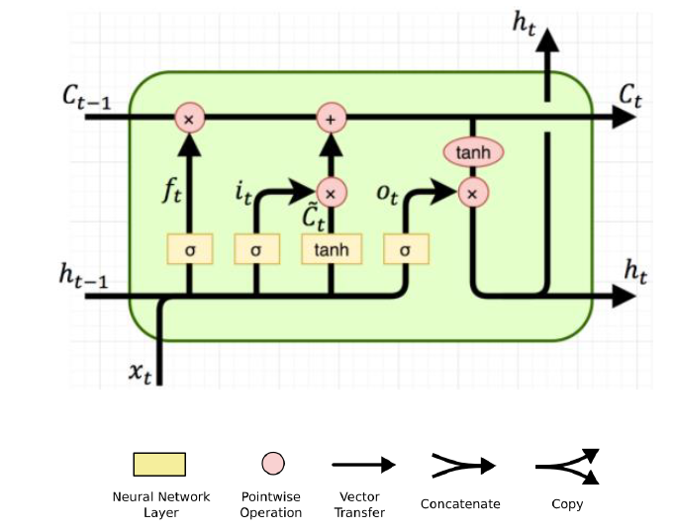
Long Short Term Memory
The RNN model which uses memory to learn and improve the results.
Consists of Input Gate, Forget Gate and Output gate.

Slide 10
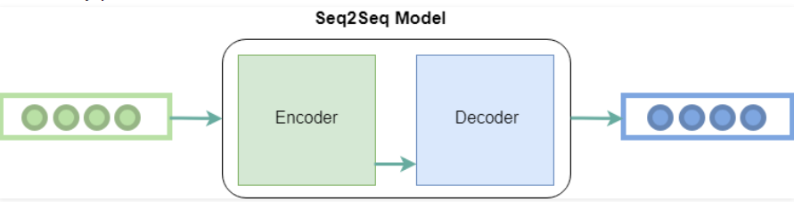
Seq2Seq modelling
Takes as input a sequence of words(sentence or sentences) and generates an output sequence of words
It has two components i.e encoder and decoder, and hence sometimes it is called the Encoder-Decoder Network.

Slide 11
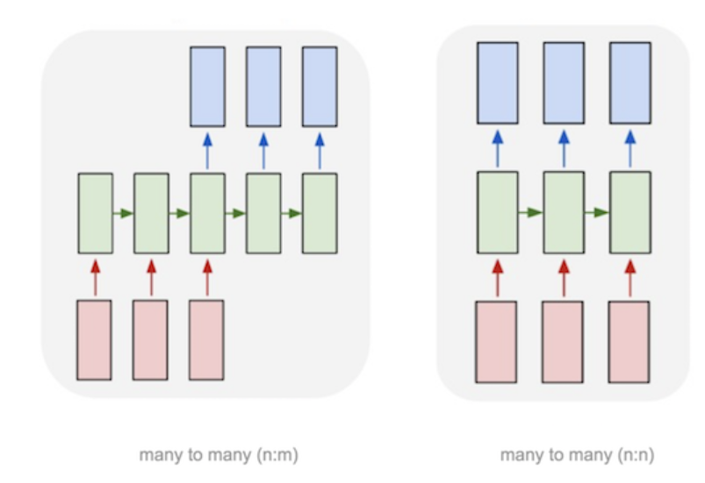
Seq2Seq modelling
Many to many modelling

Slide 12
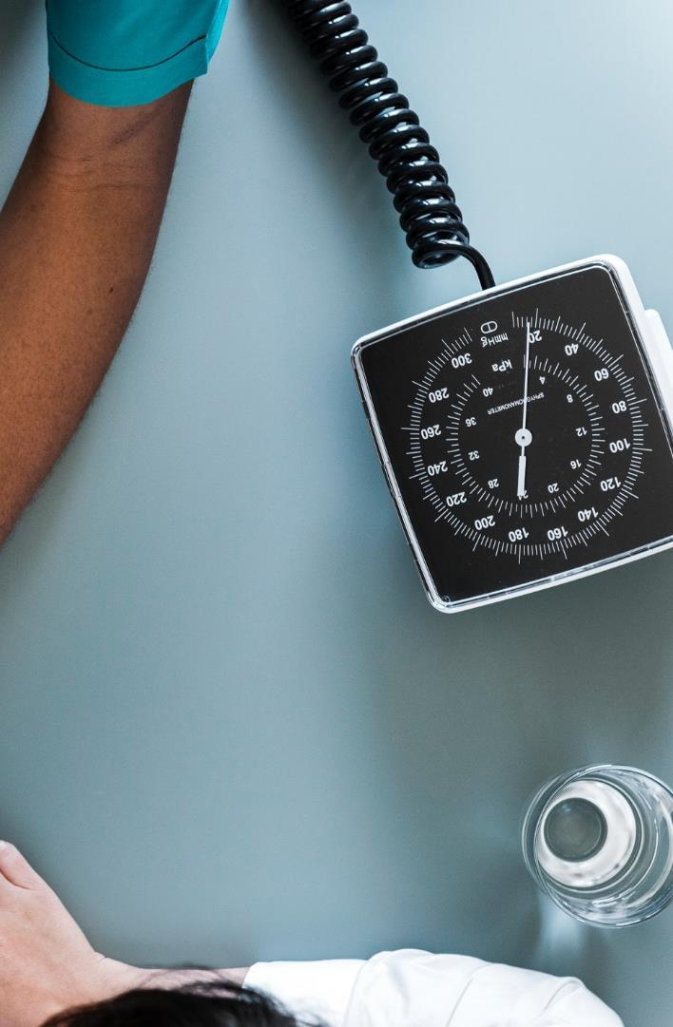




Bottlenecks
Training Rate
Data
The training rate is slow since the person writing can type anything
Data collection is a challenge since it is Personally Identifiable information and sensitive one too
Processing Time
Accuracy
Take huge time and would require high GPU and infrastructure
The accuracy increases with high amount of data on which the model trains

Slide 13
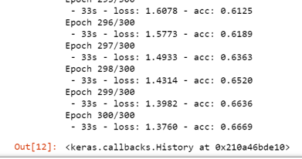
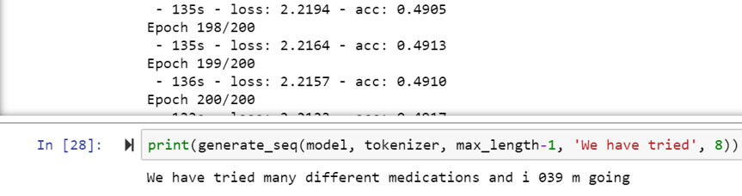
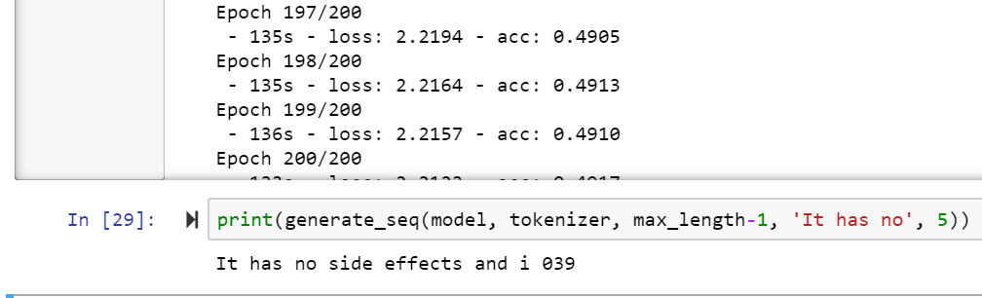
Results
Sentence Completion
Improved Accuracy
Use predictive analytics to suggest doctors possible end to their sentences
For both doctors and patients

Slide 14
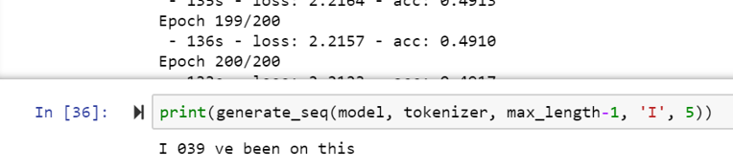
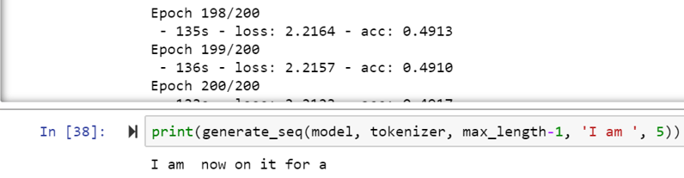
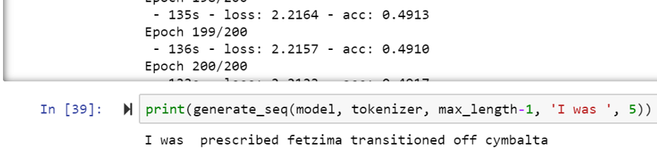
Results continued… By typing the just the letter I
Sentence Completion
Improved Accuracy
Use predictive analytics to suggest doctors possible end to their sentences
For both doctors and patients

Slide 15

The Road ahead
Feed the completed sentence back to the model to show a histogram with possible ailments
Also use demographics data and current weather conditions and area information to further screen possible diseases.
Use a browser-based editor for real time prediction

Slide 16
Demo And Questions

